Slide 1
Revolutionizing Fitness: AI-Powered Personal Trainers Personal Trainers
Let’s explore how AI-powered personalized trainers are reshaping the fitness industry. This virtual coach adapts to individual needs, providing tailored workout routines, real-time feedback, and progress tracking. Unlike traditional gym trainers, AI trainers are available 24/7, ensuring continuous support and motivation. Delve into the exciting potential of this innovation and its impact on our fitness journeys!

Slide 2

AI-Driven Fitness: The Future of Personalized Gym Coaching
An AI-based fitness trainer is a promising idea that leverages the power of AI to provide personalized fitness guidance and support.
This personal fitness trainer would generate personalized fitness roadmap, workout plans, monitor progress, watch out posture while working out, provide feedback and keep motivated
Starting from the initial plan based on the recommendation based on the user’s initial body metrics and fitness goals, it can adapt to the user’s current progress offering a highly customized fitness experience.
The AI can also integrate with wearable devices to track vital signs, activity levels, and even sleep patterns, adjusting the program accordingly

Slide 3

Approach: AI Gym Trainer Project
Develop AI System: Below is the proposed high level design of the AI pipeline:
Data Collection and Preprocessing: Collect data from the user, such as age, fitness level, goals, preferences, and any wearable data.
Model Selection:
Use a recommender system to generate initial workout suggestions.
Apply a deep learning model to personalize the plan further based on detailed user data.
Integrate reinforcement learning to adjust the workout plan dynamically as the user progresses.
Real-Time Feedback: Use CNNs (Computer Vision) to monitor user form and adjust the workout in real-time.
Continuous Learning: Implement reinforcement learning to refine the plan based on the user’s adherence and performance.
User Interface & Integration: Create a mobile app using React Native for users to input data and receive personalized plans. Connect to back-end AI via Flask/Django.
Testing & Deployment: Test the system with various user profiles, deploy on cloud platforms (AWS/Google Cloud), and iterate based on user feedback for improvement.

Slide 4

FEASIBILITY AND VIABILITY
Challenges and Considerations:
Data Privacy:Ensuring the security of sensitive health data collected by the AI.
Accuracy of Feedback:Continuously improving the AI’s ability to provide accurate form correction and advice
Engagement:Maintaining user motivation and engagement over the long term, perhaps through gamification or social features.
Technical Feasibility: AI models for personalized fitness and diet plans are achievable through ML Models, and real-time data can be integrated using APIs from wearables (Google Fit, Fitbit). Workout pose correction can be achieved through models like PoseNET, etc. Building an app (React/Flutter) and deploying on cloud platforms like AWS is practical
Market Feasibility: There is strong demand for personalized fitness solutions, and an AI-driven trainer offers a cost-effective alternative to personal trainers.

Slide 5
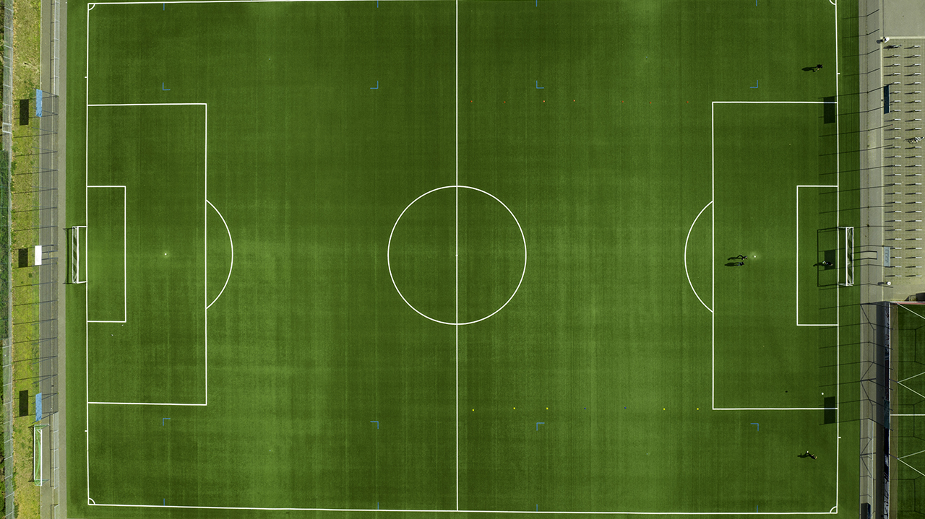
IMPACTS
Accessibility: Makes personalized fitness training available to a broader audience, regardless of location or budget.
Consistency: Helps users stay on track with their fitness goals by providing continuous support and adapting to their needs.
Safety: Reduces the risk of injury by offering real-time feedback on form and technique, especially for beginners.
Efficiency: Maximizes workout efficiency by tailoring routines to the user’s specific needs and adjusting them based on real-time data.

Slide 6

Benefits
Efficiency: Users achieve their fitness goals more efficiently as the AI optimizes the workout plan for maximum effectiveness.
Adaptability: The plan evolves with the user’s progress, ensuring that the workouts remain challenging and effective.
Personalization: The AI accounts for personal preferences and limitations, making the workout experience enjoyable and sustainable.
Motivation: Seeing personalized progress can boost motivation and adherence to the fitness routine.

Slide 7

RESEARCH AND REFERENCES
https://github.com/tensorflow/tfjs-models/tree/master/pose-detection
The Future of AI in Gyms: Exploring InnovativePossibilities (gymmanagement-software.com)
No Data Scientist Required:How Gyms and Fitness Clubs are Leveraging AI and Machine Learning | Keepme

